Slide 1

Fair Housing Essentials
Sally santangelo

Slide 2
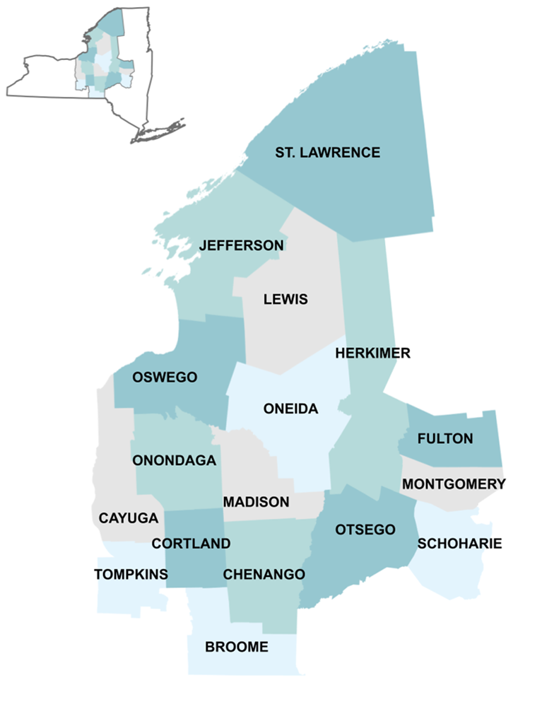
CNY Fair Housing’s Services
Investigate complaints of discrimination
Conduct undercover testing
Provide counseling and advocacy to individuals whose housing rights are being violated
Provide legal representation to victims
Conduct education and outreach on fair housing rights and responsibilities
Conduct research and engage in advocacy to increase housing opportunity
Assist tenant associations with development and collective advocacy
Provide counseling and support to households moving to well-resourced communities

Slide 3
Intake and Investigation Process
All intakes are received through either our central line (315-471-0420) or email (info@cnyfairhousing.org).
A preliminary screening for fair housing issues with be done by a member of the intake staff.
If the case could reasonably involve fair housing issues, a full intake will be done.
Depending on the facts, the complaint could move to:
  Landlord Advocacy
  Undercover Testing
Based on the results of those activities, a complaint may then be referred to our legal staff to potentially file in court or with an administrative agency.

Slide 4
Disclaimer
Nothing presented here either verbally or in writing is legal advice. Please consult an attorney for legal advice.

Slide 5
Federal and State Fair Housing Laws
Prohibit discrimination in the sale, rental, or financing of dwellings,
and in other housing-related activities
Federal Fair Housing Act
Race
Color
National Origin
Religion
Sex (interpreted to include sexual orientation)
Disability
Familial Status
New York State Human Rights Law
FHA protected classes, plus …
Age
Marital Status
Military Status
Sexual Orientation
Gender Identity
Lawful Source of Income
Domestic Violence Victim Status
Citizenship or Immigration Status

Slide 6

Who (and what) is covered by fair housing laws?
What housing is covered?
  In New York State, almost all types of housing are covered including apartments, assisted living, transitional housing, and homeless shelters used as residences.
  Exceptions for owner occupied buildings with two units or less and for the selection of same sex roommates
  Race and color protections apply in all housing transactions
  Senior housing is permitted and is exempt from familial status and age protections (must follow Housing for Older Person’s Act)
Fair Housing laws apply to:
  Landlords
  Housing staff
  Leasing agents
  Management companies
  Real estate agents and brokers
  Owners
  Homeowner’s insurers
  Mortgage lenders

Slide 7
Prohibited Conduct
A housing provider cannot, on the basis of a protected class:
  Refuse to rent or sell a dwelling
  Lie about the availability of housing
  Discriminate in the terms, conditions, or privileges of sale or rental of housing, or in the services or facilities connected to it

Slide 8
Prohibited Conduct
Examples of differential treatment:
  Differences in application process or requirements
  Require more invasive background checks
  Differences in the information someone is given about an apartment
  Charging higher rents because they have children or have a disability
  Applying property rules differently because of protected status
  Steer applicants into or away from certain areas of a building or to different buildings or neighborhoods to segregate populations

Slide 9
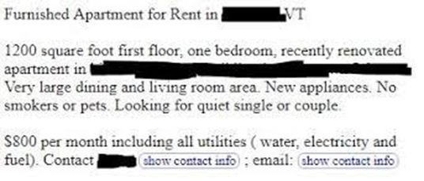
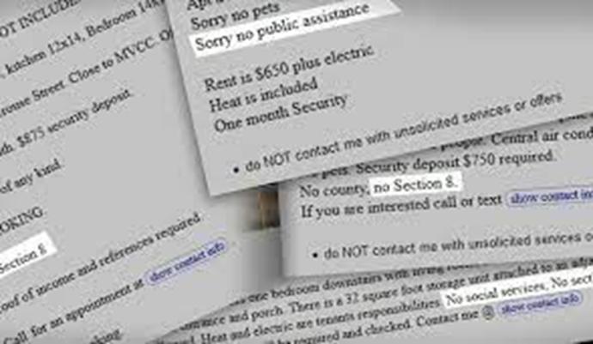
Prohibited Conduct
Discriminatory Advertising & Statements
To make, print or publish any notice, advertising or statement that indicates a preference, limitation, or discrimination.
  This includes posted signs, Craigslist, Facebook, and others

Slide 10

Prohibited Conduct
Discrimination in Residential Real Estate-Related Transactions
  Includes:
    Making or purchasing of loans or providing other financial assistance for a dwelling or lending secured by residential real estate
      Maternity leave denials
      Steering
      Language Access
      Source of Income
    The selling, brokering, or appraising of residential real property
      Racial discrimination in appraisals

Slide 11
Familial Status
Familial Status: families with children under the age of 18, pregnant people, anyone who has or is trying to obtain custody of minor children (adoption, foster care, grandparents)
Landlords can limit the number of people that live in an apartment, but it has to be based on the size of the apartment and is determined by local codes.
Very small bedrooms can be limited to one person while large bedrooms may be able to have three or more people
Children under 2 do not count when determining the number of people per bedroom.
Student Housing presents problems if families aren’t permitted to rent and if there are strict one person per bedroom policies or separate leases required for each occupant.

Slide 12

Current Source of Income Laws
2019 - New York State added “lawful source of income” as a protected class under the state fair housing laws
  individuals can not be discriminated against due to the source of the income they use to pay housing costs
  law includes all legal sources of income such as Section 8 vouchers, SSI, SSD, Public Assistance, HOPWA subsidies, Olmstead vouchers, child support, and alimony.
  includes one-time payments and emergency payments such as security deposit agreements from DSS or ERAP

Slide 13
What about income & credit requirements?
Income requirements:
Can only apply to the tenant’s portion of the rent. Policies that effectively keep a voucher holder from being able to rent may be discriminatory.
Credit Requirements:
While there is no definitive case law on this, there may be situations where use of a credit score to disqualify a tenant with a subsidy could be discriminatory.

Slide 14

Rent Amounts for Section 8 Tenants
Housing providers cannot charge more for Section 8 tenants unless the unit is receiving another subsidy like LIHTC
Tenants can rent any unit within the payment standard for their voucher. Payment standards are set according to the Fair Market Rent or FMR of an area. Individual housing authorities have discretion to set their voucher values between 90 and 110% of FMR.

Slide 15
Domestic Violence
Domestic violence survivors are protected under fair housing laws and other state laws
Housing providers can not evict domestic violence survivors because of incidents or police activity at the property
Permissible Evictions –
Domestic violence survivors living in subsidized properties have rights under VAWA
Emergency transfers
Self-certification by survivors
Can’t deny housing due to adverse effects of abuse
Other violation of the lease not related to the domestic violence as long as survivor is not subjected to stricter standard
Actual or imminent threat to employees or others at the property and there are no other actions that can be taken to reduce the threat

Slide 16
Domestic Violence
Local governments can not require that landlords evict domestic violence survivors because of police activity
Target Calls for Police Activity
Designate property as a nuisance – no exception for victims of crime or for emergency aid
Penalties include civil and criminal fines, revocation of rental permits, certificate of occupancy

Slide 17
Criminal Background Screening
Blanket bans on individuals with criminal legal system involvement or denials based on arrest record alone are considered discriminatory
Housing provider should conduct an individualized assessment that considers:
Nature and severity of offence
Time since conviction
Behavior in intervening time
Provider should be prepared to show their policy serves a “substantial, legitimate, nondiscriminatory interest”
Criminal Background Check Toolkit
NYS Justice Involved Worksheet
NYS Guidance for Justice Involved Cases

Slide 18

Limited English Proficiency
Refusal to rent to households simply because they do not speak English constitutes discrimination on the basis of national origin.
NY State funded properties have additional requirements for LEP residents.
  Provide interpretation services in any language and translation of vital documents into 12 most common languages.
HUD moved to an English only policy effective Sept. 1st, 2025

Slide 19

Harassment in Housing
Fair Housing Act and New York State Human Rights Law provide protections against harassment based on protected class
Includes Harassment based on Race, Ethnicity, Sexual Orientation, Disability, etc.
Sexual harassment is covered under gender protections
Two types of harassment:
Quid pro quo – involves the exchange of sexual favors for rental benefits
Hostile environment – severe and pervasive conduct that creates a hostile environment

Slide 20
Harassment
Harassment can be written, verbal, or other conduct, and does not require physical contact
A housing provider cannot retaliate because someone asserted their fair housing rights or helped someone else assert their fair housing rights

Slide 21

Hostile Environment Harassment
Examples:
Use of lewd comments or gestures
Exposure
Use of gender-related derogatory comments
Displays of lewd photos or pictures
Asking about sex life or relationships
Use of racial and ethnic slurs
Derogatory comments about disability
  Factors considered to determine whether hostile environment exists:
  nature and context of the conduct
  severity, scope, frequency, duration, and location of the conduct
  relationships of the persons involved
  even a single event that it is severe enough, can still arise to the level of hostile environment

Slide 22
Quid Pro Quo Harassment
Involves an exchange or request for sexual favors for rental benefits
Rental benefits may include:
Ability to rent an apartment
Favorable application review
Reduction in rent
Reduction in security deposit
Maintenance
Forgiveness of back rent

Slide 23
Quid Pro Quo Harassment
  Requests may be explicit or subtle:
Suggestions of trades
Suggestions of “owing” something to landlord
Requests for dates
Attempts by landlord to get tenant alone
Even if the tenant acquiesces, it is still sexual harassment.

Slide 24
Disability Discrimination
“Any person who has a physical or mental impairment that substantially limits one or more major life activities; has a record of such impairment; or is regarded as having such an impairment.”
mobility impairments
visual or hearing impairments
major diseases
mental illness
depression
anxiety
PTSD
autism
Housing providers:
  Cannot refuse to rent or sell to prospective residents based upon their disability
  Should not ask questions about the nature or extent of a person’s disability
  Can ask ALL tenants if they can meet the obligations of tenancy

Slide 25

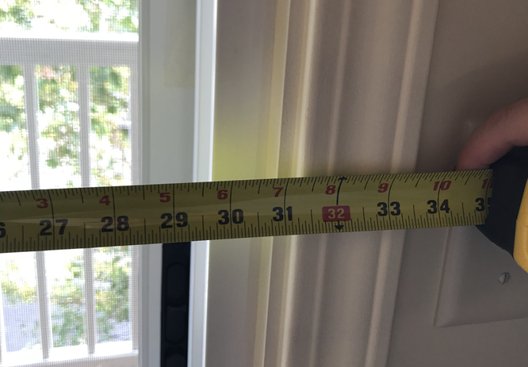
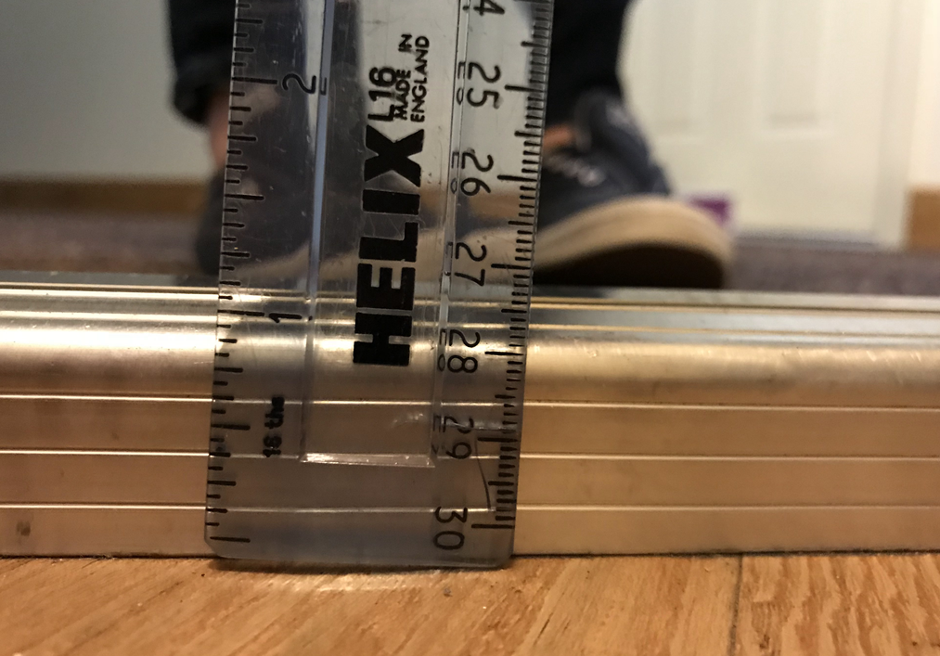
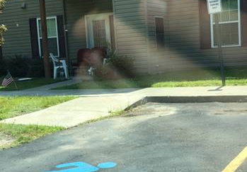
Design & Construction
Buildings containing 4 or more units built after 1991 must meet minimum accessibility standards
Common violations:
  Thresholds at doorways, especially balconies and patios
  Insufficient door width
  Maneuvering space in bathrooms and kitchens
  Lack of access at common amenities like garages, storage spaces, and mailboxes
  Lack of access at rental offices
  Lack of curb cuts, excessive slope on sidewalks

Slide 26
Reasonable Accommodations
A change, exception, or adjustment in normal rules, policies, practices, or services offered by a housing provider to allow persons with disabilities the full use and enjoyment of their dwelling and related facilities.
Assistance animals
Assigned parking spaces
Transferring Units
Communication methods
Trash Pickup
Snow Removal
Leniency for behavior that violates a lease

Slide 27
Reasonable Modifications
A structural modification that is made to allow persons with disabilities the full use and enjoyment of their dwelling and related facilities.
Ramps
Grab bars
Sidewalks
Power Assisted Doors
Flashing smoke alarms or doorbells

Slide 28
Reasonable Modifications
Federally subsidized housing (includes HUD and USDA subsidized housing) - housing provider is responsible for costs of all modifications.
Private housing - tenant is responsible for paying for modifications within their units while the landlord is responsible for paying for some modifications to common areas.
If modifications are necessary due to failure to comply with design and construction standards, the housing provider is responsible for paying for the modification

Slide 29
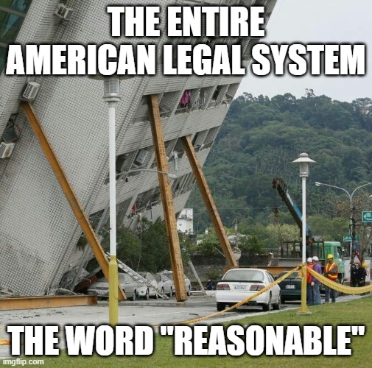
What is Reasonable?
Changes that do not impose an undue financial and administrative burden or that would fundamentally alter the provider’s operations
Takes into account:
  the financial resources of the provider
  the costs of the accommodation or modification
  the benefits to the requester
  the availability or other, less expensive alternative options

Slide 30
What is required to request a reasonable accommodation or modification?
Request does not need to be made in a particular way
  Recommend that requests be made in writing and ask that the housing provider responds in writing
  Housing provider may have a particular form or process, but they can’t require tenant use that form or process.
If the disability is not obvious, landlord can request information from a third party that:
  verifies that they meet the Act’s definition of disability
  describes the needed accommodation or modification
  shows the relationship between the person’s disability and the need for the requested accommodation and modification
CNY Fair Housing Website
CNYFH Website - Disability - Accommodations

Slide 31
How can a housing provider verify that a tenant has a disability?
Verification does not need to be from a doctor but should be someone familiar with the disability and need.
  Best practice - verification from someone with professional training though in limited circumstances there may be exceptions if that is not possible.
A housing provider can not ask for information about the individual’s diagnosis or other treatment they have pursued including asking for information about medications the individual is taking or has taken in the past.

Slide 32
Can a housing provider charge fees for accommodations?
Housing provider cannot charge additional fees as a condition of granting the accommodation or modification
  Includes pet fees and pet deposits for assistance animals, parking fees, or transfer fees if an individual needs to switch units for a disability related need
  Cannot be called an “administrative fee”

Slide 33
What animals can be considered support animals?
All animals reasonably kept in households, including a dog, cat, small bird, rabbit, hamster, gerbil, other rodent, fish, turtle, or other small, domesticated animal that is traditionally kept in the home for pleasure rather than for commercial purposes.
Unique animals or multiple animals may be requested as support animals, but the requester must specifically demonstrate a disability-related need for that specific animal.

Slide 34
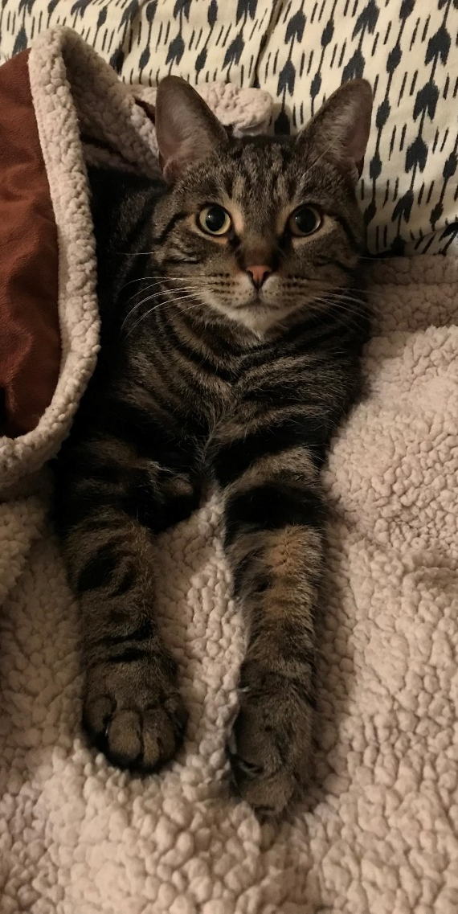

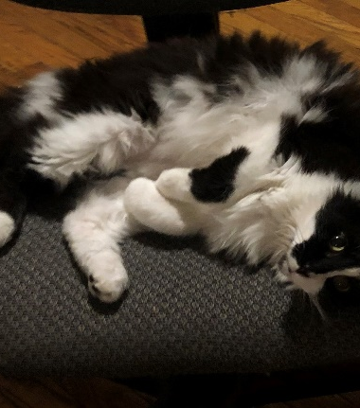

What if the animal is dangerous?
If the requested animal is dangerous or becomes dangerous to other tenants or property, the housing provider can require that the animal no longer be allowed in the housing. This includes biting or menacing behavior, but does not include typical animal behavior such as occasional noise making.

Slide 35
What restrictions can a landlord place on an animal?
Reasonable restrictions would include anything that would be covered by local laws such as using a leash in common areas, vaccinations, and picking up after the animal.
Excessive restrictions may include:
  Breed and size restrictions
  Excessive safety restrictions that are unrelated to the animal’s behavior
  Not allowing the animal in common areas
  Forcing the animal to leave the property to relieve itself
  Strict no barking policies

Slide 36
Enforcement of Fair Housing Complaints
  Fair Housing complaints can be filed in:
    Federal Court: if there are claims covered under the Fair Housing Act (e.g. disability)
    State Court: if there are claims covered under state Human Rights Law (e.g. source of income)
    HUD
    NYS Division of Human Rights

Slide 37
Remedies in Fair Housing Cases
  Monetary Damages:
  Compensatory damages (moving costs, missed work)
  Emotional damages (mental anguish and humiliation)
  Punitive damages - acted with knowledge that the action violated the law or with reckless indifference to the plaintiff’s rights
Injunctive Relief:
  Affirmative remedies (e.g. requiring landlord to rent to tenant, requiring affirmative marketing)
  Training
  Continued monitoring

Slide 38

Tenant Dignity & Safe Housing Act
Article 7-D of the Real Property Actions and Proceedings Law provides a new right of action for tenants to sue landlords in a summary proceeding to compel repairs and other relief if the residential property violates local and state housing standards or the warranty of habitability per Real Property Law § 235-b
Passed the legislature in June 2022 (S4594-B)
Signed by the governor December 2022, but effective date delayed so there could be a chapter amendment
Chapter amendment (S1332) signed in March 30, 2023, with several changes
Effective 12/30/2023 (originally to take effect 180 days after signing)

Slide 39
Instructions for Pro Se Tenants
OCA created pro se forms for Article 7d petitions
Pro se forms available at: https://ww2.nycourts.gov/article-7-d-english-36716
Most court clerks will provide the forms to pro se litigants
Filing fee $45
Fee can be waived for indigent persons
Fee waiver application available at: https://ww2.nycourts.gov/fee-waiver-application-36856

Slide 40
Pro se form

Slide 42
Fair Housing
Questions/Inquiries?
CNY Fair Housing, Inc.
731 James Street, Suite 200
Syracuse, NY 13203
Phone: (315) 471-0420
Website: www.cnyfairhousing.org

