Slide 1
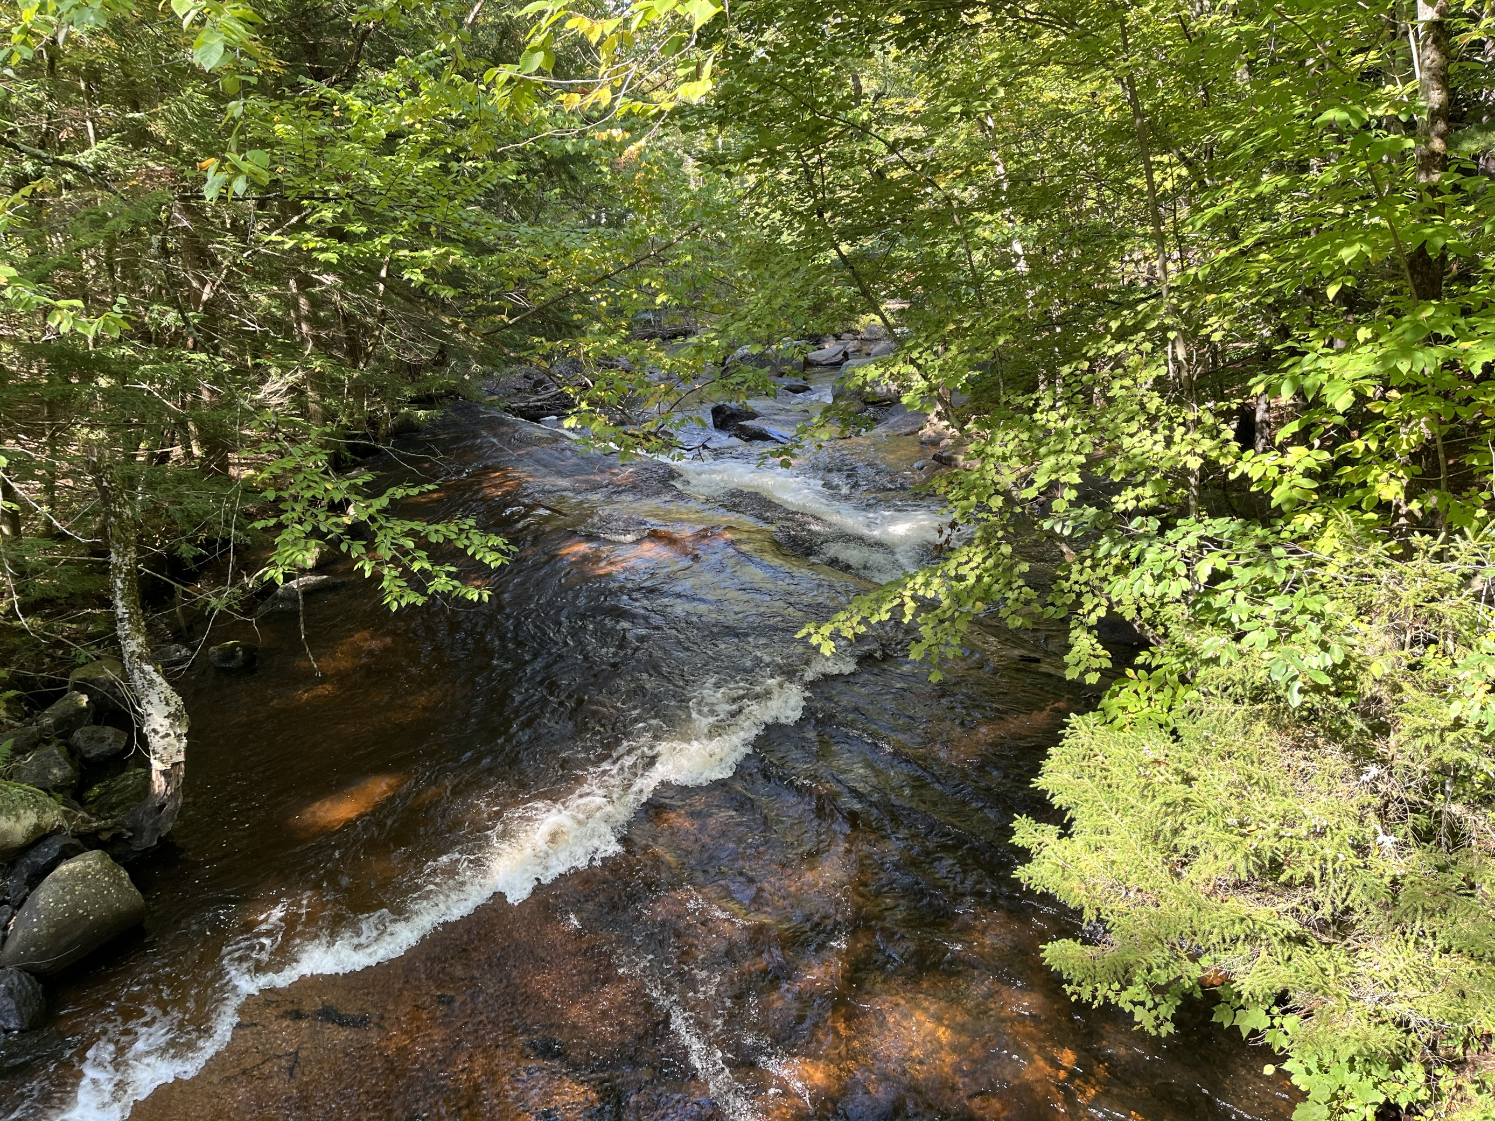

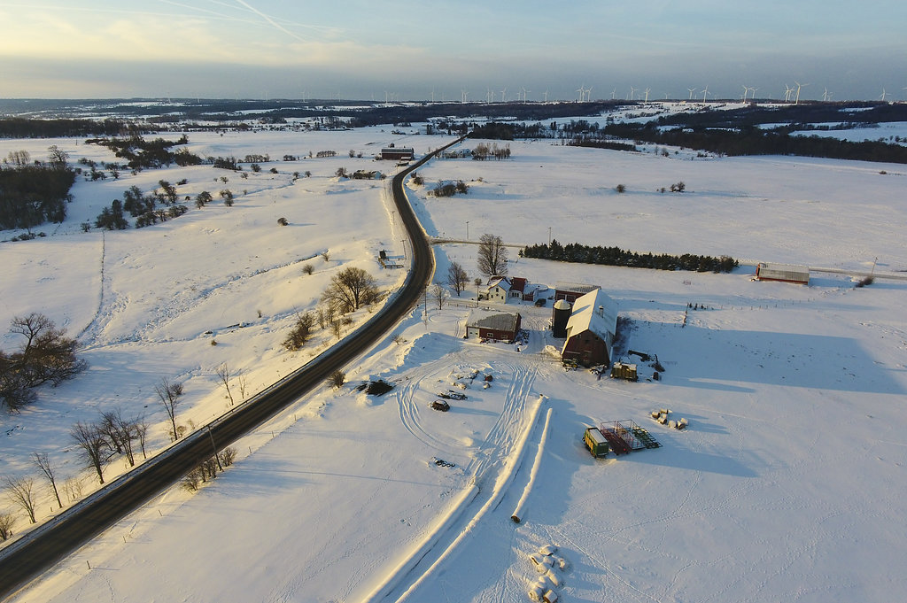
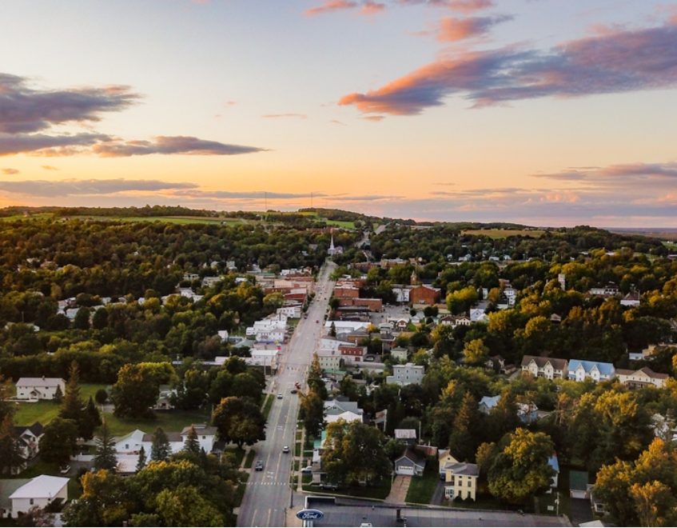

2026 Tentative Budget

Slide 2

2026 Budget Overview
Process
Transparency
Targets
Drivers
Fund Balance
Revenue
Expenses
Tax Rate & Equalization

Slide 3
2026 Budget Process
1 Jul.
Departments Begin Inputting Budget Requests
21 Jul. - 1 Aug.
County Manager and County Treasurer meet with Department Heads
16 Sep.
Committees Discuss Preliminary Budget Issues
(Personnel & Capital)
21 Oct.
Budget Workshop
4 Nov.
Tentative Budget Presented to BOL
18 Nov.
Budget Hearing
Budget can be Adopted Anytime After Hearing

Slide 4
2026
Budget Workshop
Preview of the 2026 Tentative Budget
Consensus-building before official Tentative Budget (10/21)
Open discussion
Opportunity for Questions and Input
Additional “workshops” can be scheduled if necessary
Focus on “broad strokes” rather than department-by-department rundown

Slide 5
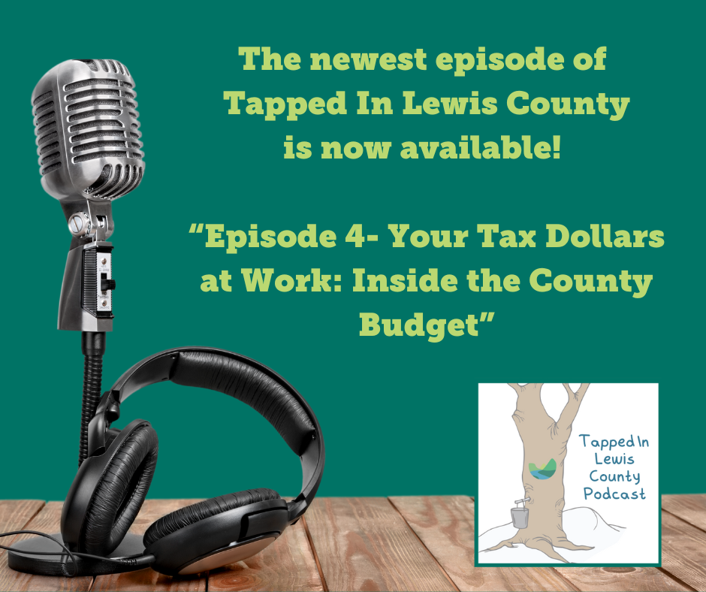
Tapped In Lewis County Podcast
Ever wonder where your tax dollars go or how county decisions are made? This episode of our podcast pulls back the curtain on county finances—breaking down the budget and explaining how choices at the top impact your everyday life.
The podcast is available on our website as well as your favorite streaming service!
Click here to give it a listen: Your Tax Dollars at Work: Inside the County Budget

Slide 6
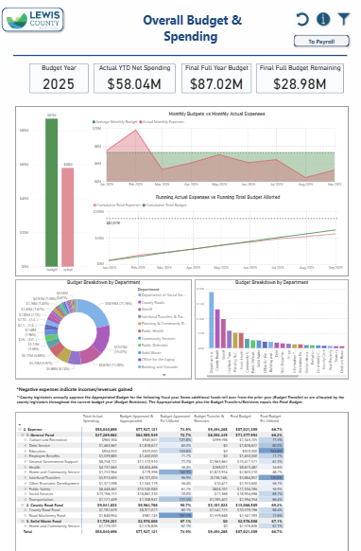
2026
Budget
Public Dashboards
Budget Data Transparency - Power BI Report - Lewis County, NY

Slide 7
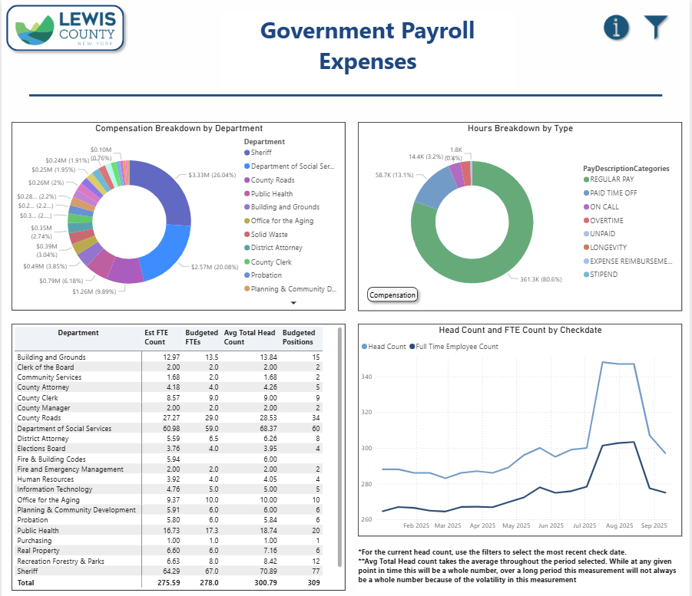
2026
Budget
Public Dashboards

Slide 8

Fiscal Targets Est. 2023
Maintain
Maintain a General Fund Balance between 10% and 30% of annual operations
Maintain
Maintain a Health System Fund Balance of at least 16% of annual operations
Retain
Retain A+ Credit Rating
Invest
Invest at least 3% of annual operating budget into capital equipment and projects
Maintain
Maintain a debt ratio of no greater than 50% of the constitutional limit

Slide 9
Maintain a debt Limit of no more than 50% of constitutional limit
  2008 Court House Bond= $5,475,000 (Matures 2037)
  2022 Building Projects Bond = $16,270,000 (Matures 2042)
Total Debt = $21,745,000
  In New York State, there are constitutional limits to how much debt a local government or school district can incur.
  The debt limit is 7% percent of the five-year average full valuation of taxable property within a municipality.
  $3,364,635,305 x 7% = 235,524,471
  If we include the Hospital, the total Debt is approximately $51,900,000
Notes:
Court House Bond
Due on May 15
Principal $385,000
Interest $91,387.50
Due on Nov 15
Interest $85,612.50
Bond matures on 5/15/2037
2022 Facilities Bond
Due on April 15
Principal $696,600
Interest $290,673
Due on Oct 15
Interest $279,353.25
Bond matures on 4/15/2042

Slide 10
Fund Balance Summary
Fund | Current Fund Balance (09/30/2025)
General Fund | $21,023,000 current total. Unallocated total estimate for 12/31/2025 is $12,800,000
County Road | 12/31/2025 Estimate - $830,000
Highway Machinery | 12/31/2025 Estimate - $(1,200,000) due to intercompany equipment loans
Solid Waste | 12/31/2025 Estimate - $230,000
Workers Compensation Insurance Fund | 12/31/2025 Estimate - $3,800,000
Health Insurance Fund | 12/31/2025 Estimate - $2,500,000
Capital | 12/31/2025 Estimate - $4,200,000

Slide 11
Fund Balance Target 10% to 30% of Operating Budget
  General Fund Operating Budget = $71,044,550
  Unallocated Fund Balance Projection – December 31, 2025, = $12,800,000
  Fund Balance as a Percentage of Operating Expenses = 18%

Slide 12
General Fund Balance

Slide 13
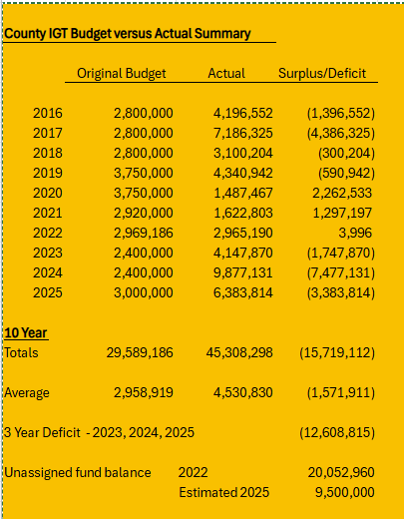
Fund Balance IGT Budget Vs. Actual

Slide 14
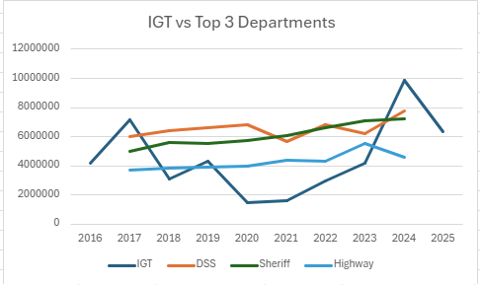
IGT Actual Vs. Other High Cost

Slide 15
2026
Budget Drivers
  Income
    Assessed value grew at 6.5%
    Sales Tax increased by $550,000
    $200,000 reduction in flat rock wind pilot
    $600,000 reduction in interest income
  Expense
    Health Insurance
    Retirement Costs
    FTE’s are down 15, minimizing labor impact
  Fund Balance Health
    Need to improve fund balance in future years

Slide 16
Budget Summary
Fund | 2026 Budget
General Fund | $71,044,550
County Road | $9,123,696
County Machinery | $956,338
Solid Waste | $2,570,557
Total Budget | $83,695,141
Lewis County General Hospital | $112,045,940
Total Budget | $195,741,081

Slide 17
Revenue
$69,144,550 (Total General Fund Budget) = 6,059,001 Increase
  9.6% Increase over 2025
Departmental Non-Tax Revenue
  $29,878,177 = $4,671,820 increase
  18.5% increase over 2025
Sales Tax
  $18,500,000 = $550,000 increase
  3.1% increase over 2025
Property Tax
  $20,766,373 = 837,182 increase

Slide 18
Note: 2025 is YTD through Oct. 3, 2025

Slide 19
Property Value
  Assessed value continues to grow
    $3,364,634,305 (Total valuation)
    $203,585,842 (increased valuation)
    $20,766,373 (levied against this valuation)

Slide 20
Full
Taxable
Value

Slide 21
Levy
  $71,044,550 (Total General Fund expenses)
    -29,878,177 (Non-Tax Revenue)
    -$18,500,000 (Sales Tax)
    -$1,900,000 (fund Balance)
    $20,766,373 (Levy)
    This is a $837,182 Increase

Slide 22
Property Tax Levy

Slide 23
Tax Rate
  $71,044,550 (Total Budget)
    -$ 29,878,177 (Non-Tax Revenue)
    -$ 18,500,000 (Sales Tax)
    -$ 1,900,000 (Fund Balance)
    $ 20,766,373 (Levy) /
    $ 3,364,634,305 (Assessed Value) / 1,000
    $ 6.17 Per $1,000 of assessed Value
    2025 rate was $6.31
    .14 cents per $1,000 of assessed value decrease.
    2.09% decrease in tax rate

Slide 24
No increase in the Tax Rate

Slide 25
Town | 2025 Taxable Full Value |  | 2026 Taxable Full Value |  | Percent Change |  | Explanation:
CROGHAN | 423,389,892 |  | 452,235,584 |  | 6.81% |  | Equalization rate decreased from 46.5% to 44%
DENMARK | 206,399,404 |  | 222,334,392 |  | 7.72% |  | Equalization rate decreased from 81.5% to 76.5%
DIANA | 228,250,716 |  | 239,114,582 |  | 4.76% |  | Equalization rate decreased from 99% to 97%
GREIG | 331,702,845 |  | 357,758,615 |  | 7.86% |  | Equalization rate decreased from 69.5% to 65%
HARRISBURG | 60,675,182 |  | 64,972,303 |  | 7.08% |  | Equalization rate decreased from 74% to 70%
LEWIS | 113,111,091 |  | 116,868,507 |  | 3.32% |  | Equalization rate decreased from 54.09% to 53.3%
LEYDEN | 143,172,215 |  | 151,126,889 |  | 5.56% |  | Equalization rate decreased from 75% to 71%
LOWVILLE | 365,734,467 |  | 404,202,738 |  | 10.52% |  | Town wide revaluation project
LYONSDALE | 145,073,279 |  | 152,171,230 |  | 4.89% |  | Equalization rate decreased from 58% to 54%
MARTINSBURG | 153,804,441 |  | 156,087,367 |  | 1.48% |  | No change in Eq Rate/ No major assessment adjustments
MONTAGUE | 51,020,219 |  | 54,374,197 |  | 6.57% |  | Equalization rate decreased from 75.5% to 71%
NEW BREMEN | 237,238,773 |  | 245,464,052 |  | 3.47% |  | Equalization rate decreased from 77% to 74.5%
OSCEOLA | 64,840,825 |  | 75,402,811 |  | 16.29% |  | Equalization rate decreased from 75.5% to 64.5%
PINCKNEY | 44,440,770 |  | 47,448,082 |  | 6.77% |  | Equalization rate decreased from 88% to 83%
TURIN | 110,508,635 |  | 114,587,762 |  | 3.69% |  | Equalization rate decreased from 73.5% to 71%
WATSON | 284,499,009 |  | 306,296,282 |  | 7.66% |  | Equalization rate decreased from 75.5% to 71%
WEST TURIN | 197,186,699 |  | 204,189,912 |  | 3.55% |  | Equalization rate decreased from 68% to 66%
OVERALL | 3,161,048,463 |  | 3,364,634,305 |  | 6.44%
For 2025, the state sales trends were between 0 and +6% causing the town equalization rates to drop in most municipalities. When an equalization rate drops, the full value increases even if there is no change to the assessed value. The town of Lowville was the only town wide revaluation project completed in 2025.
Residential property trends were +4% for 2025 • Commercial property trends were between 0% and +3% • Vacant, Farm & Forest property trends between +5% and +6%

Slide 26
Town | 2025 Rate | Tentative 2026 Rate | Percent Change
LEWIS COUNTY | 6.304758 | 6.171977 | -2%
CROGHAN | 13.559085 | 14.027960 | 3%
DENMARK | 7.735861 | 8.068056 | 4%
DIANA | 6.368447 | 6.362984 | 0%
GREIG | 9.071541 | 9.495472 | 5%
HARRISBURG | 8.519749 | 8.817077 | 3%
LEWIS | 11.655785 | 11.579650 | -1%
LEYDEN | 8.406152 | 8.692892 | 3%
LOWVILLE | 6.636465 | 6.171977 | -7%
LYONSDALE | 10.871961 | 11.431628 | 5%
MARTINSBURG | 6.304758 | 6.172092 | -2%
MONTAGUE | 8.350482 | 8.692892 | 4%
NEW BREMEN | 8.188012 | 8.284705 | 1%
OSCEOLA | 8.350482 | 9.568920 | 15%
PINCKNEY | 7.164334 | 7.436089 | 4%
TURIN | 8.577706 | 8.692892 | 1%
WATSON | 8.350675 | 8.693092 | 4%
WEST TURIN | 9.271699 | 9.351653 | 1%
2026 Rate Change Including Equalization

Slide 27
Budget Summary
 | 2025 Adopted Budget | 2026 Budget Draft | Year-Over-Year Difference | % Change
Total Appropriations | $ 64,985,549 | $71,044,550 | $6,059,001 | 9.3%
Total Revenue | $ 43,156,358 | $48,378,177 | $5,221,820 | 12.1%
Balance Raised by Taxes | $21,829,191 | $22,666,373 | $837,181 | 3.8%
Less Applied Fund Balance | $1,900,000 | $1,900,000 | $0 | 0%
Property Tax Levy | $19,929,191 | $20,766,373 | $837,181 | 4.03%
Taxable Value | $3,161,048,463 | $3,364,634,305 | $203,585,842 | 6.4%
County Tax Rate | 6.31 | 6.17 | (0.14) | -(2.22)%

Slide 28
Budget Details Expenses

Slide 29
Labor Totals
Headcount
FTE
  2025 = 345
  2026 = 325
  2025 = 300
  2026 = 285
FTE Reductions by Department
  7 - Department of Social Services (- $520K)
  1 - Buildings & Grounds (- $74K)
  1 - Highway (- $68K)
  1 - Real Property (- $71K)
  0.5 - County Attorney (- $51K)
  4.5 - Recreation, Forestry & Parks (- $204K)
  1 - Public Health (- $92K)
Total Estimated Compensation Reduction ~ $1M
*Note compensation has other funding streams and not fully funded by taxpayers

Slide 30
Labor Impact
$14,969
Decrease
  Labor Cost
    All funds $18,753,278
    1.0% increase from 2025
    $183,980 increase
  Health Insurance
    All funds $5,014,353
    3.1% decrease from 2025
    $158,689 decrease
  Retiree Health
    All funds $1,920,357
    3.0% decrease From 2025
    $59,643 Decrease
  Retirement
    All funds $2,989,517
    0.7% increase over 2025
    $19,383 Increase
  Total Burden Labor cost
  $28,677,505

Slide 31
Contingency
  Contingency: $300,000 Remains the same
  Removed $300,000 special contingency

Slide 32
Budget Changes – No Tax Impact
  Increased Revenue from Hospital $1,500,000
  Increased IGT Expense $1,500,000
  Bus Operations (Fort Drum) increased revenue $716,360
  Bus Operations (Fort Drum) increased expenses $716,360

Slide 33
Outside Agencies (Non-Departmental)
Agency | 2025 Budgeted | 2026 Requested | 2026 Draft Budget
Adirondack North Country Association | $ 3,000 | $ 3,000 | $ 3,000
Adirondack Park Council of Governments | $ 800 | $ 800 | $ 800
Advocate Drum (FDRLO) | $ 50,000 | $ 50,000 | $ 50,000
Constable Hall Association | $ 2,000 | $ 2,000 | $ 2,000
Cornell Cooperative Extension | $ 353,850 | $ 372,542 | $ 373,000
Diana Historical Museum | $ 2,000 | $ 2,000 | $ 2,000
Double Play Community Center | $ 20,000 | $ 20,000 | $ 20,000
Hand in Hand Childcare Center | $ 10,000 | $ 20,000 | $10,000
International Maple Museum | $ 2,000 | $ 2,000 | $ 2,000
JCC Center for Community Studies | $ 5,000 | $ 5,000 | $ 5,000
Snowmobile Clubs | $ 18,000 | $ 18,000 | $ 18,000

Slide 34
Outside Agencies (Non-Departmental)
Agency | 2025 Budgeted | 2026 Requested | 2026 Draft Budget
Lewis County Agricultural Society | $ 5,000 | $ 5,000 | $ 5,000
Lewis County Historical Society | $ 40,000 | $ 50,000 | $ 50,000
Lewis County Humane Society | $ 5,000 | $ 20,000 | $ 10,000
Naturally Lewis, Inc. | $ 315,000 | $ 458,391 | $ 373,000
Railroad Historical Society of NNY | $ 2,000 | $ 3,000 | $ 2,000
Lewis County Soil and Water | $ 125,000 | $ 140,000 | $ 140,000
Lyons Falls Historical Society | $ 2,000 | $ 2,000 | $ 2,000
North Country Library System | $ 45,000 | $ 45,000 | $ 45,000
Old Tyme Fiddlers Association | $ 2,000 | $ 2,000 | $ 2,000
Lewis County Food Pantries | $ 9,000 | $ 9,000 | $ 9,000

Slide 35
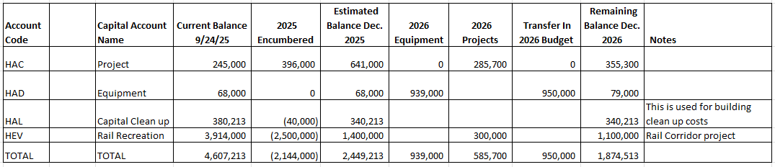
Capital Transfers

Slide 36
Continuing Our Momentum in 2026
Budget Funding
Courthouse Parking Lot: $50,000
Jail Medical Software: $49,700
Data Analytics Dashboards: $60,000
Bridge NY Funds
  Pine Grove Rd Culvert at Number 4 Rd
  Woodbattle Road
  Marshey Road
  Erie Canal Road-New Bremen
  Boshart Road-Lowville
  Eatonville Road-Greig
  Kotel Road-Watson
CHIPS
  Paving
    Number 3 Road from Village to Rice Road
    Lee Road Towns of Martinsburg/Turin
  Complete Streets
    Constableville

Slide 37
2026
Budget
Goals
  Eliminate through attrition 5 to 8 additional FTE’s
  Eliminate 3 to 5 additional pieces of equipment
  Need to build the fund balance to absorb unanticipated expenses
  Must always focus on growing revenue
    The best way to contain taxes is to expand the tax base (property taxes)
    Increase Economic Activity (sales tax )

Slide 38
Questions & Discussion
Tax Rate
  Slight decrease from last year
General Fund Balance
  Need to protect the Fund Balance
Levy
  Stays under the 2% tax cap
Additional Legislator Input

