Slide 1

Fair Housing Essentials
Sally Santangelo

Slide 2
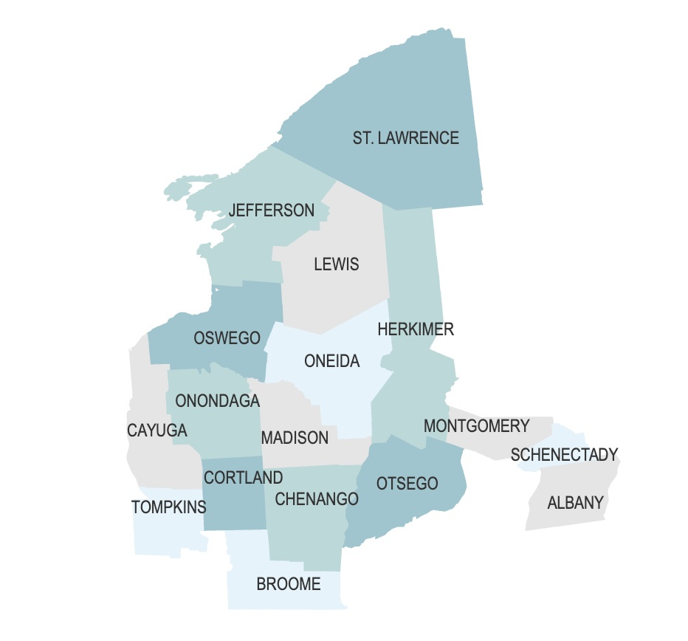
About CNY Fair Housing
Private, non-profit organization founded in 1991
Work to eliminate housing discrimination and promote housing opportunity

Slide 3

CNY Fair Housing Services
Investigations
Investigate complaints of discrimination
Testing
Conduct undercover testing
Counseling & Advocacy
Provide counseling and advocacy to individuals whose housing rights are being violated
Legal
Provide legal representation to victims
Outreach
Conduct education and outreach on fair housing rights and responsibilities
Policy
Conduct research and engage in advocacy to increase housing opportunity

Slide 4
Intake and Investigation Process
All intakes are received through either our central line (315-471-0420) or email (info@cnyfairhousing.org).
A preliminary screening for fair housing issues with be done by a member of the intake staff.
If the case could reasonably involve fair housing issues, a full intake will be done.
Depending on the facts, the complaint could move to:
  Landlord Advocacy
  Undercover Testing
Based on the results of those activities, a complaint may then be referred to our legal staff to potentially file in court or with an administrative agency.

Slide 5
Disclaimer
Nothing presented here either verbally or in writing is legal advice. Please consult an attorney for legal advice.

Slide 6

Introduction to Fair Housing Laws

Slide 7

Who (and what) is covered by fair housing laws?
What housing is covered?
  In New York State, any housing except owner-occupied buildings with two or less units (includes rooms) are covered by fair housing laws
  Race and color protections apply to every housing unit
  No exemption if the owner is “in the business of selling or renting dwellings”
  Exemption for the selection of same sex roommates
  Under certain circumstances, age-restricted senior housing is permitted and is exempt from familial status and age protections
Fair Housing laws apply to:
  Landlords
  Housing staff
  Leasing agents
  Management companies
  Real estate agents and brokers
  Owners
  Homeowner’s insurers
  Mortgage lenders

Slide 8

Protected Classes Under Fair Housing Laws
Federal Law:
Race
Color
National Origin
Religion
Sex/Gender
Disability
Familial Status
State Law:
Age
Marital Status
Military Status
Sexual Orientation
Gender Identity
Source of Income
Additional Local Laws May Apply

Slide 9
Familial Status
Familial Status: families with children under the age of 18, pregnant people, anyone who has or is trying to obtain custody of minor children (adoption, foster care, grandparents)
Landlords can limit the number of people that live in an apartment, but it has to be based on the size of the apartment and is determined by local codes.
Very small bedrooms can be limited to one person
Large bedrooms may be able to have three people
Children under 2 do not count when determining the number of people per bedroom.

Slide 10

Prohibited Conduct
A housing provider cannot, on the basis of a protected class:
  refuse to rent or sell a dwelling
  represent that any housing accommodation is not available when in fact it is available

Slide 11

Prohibited Conduct
A housing provider cannot, on the basis of a protected class:
  Discriminate against any person in the terms, conditions, or privileges of sale or rental of a dwelling, or in the provision of services or facilities in connection therewith

Slide 12
Prohibited Conduct
Examples of differential treatment:
  Differences in application process or requirements
  Require more invasive background checks
  Differences in the information someone is given about an apartment
  Charging higher rents because they have children or have a disability
  Applying property rules differently because of protected status
  Steer applicants into or away from certain areas of a building or to different buildings or neighborhoods to segregate populations

Slide 13
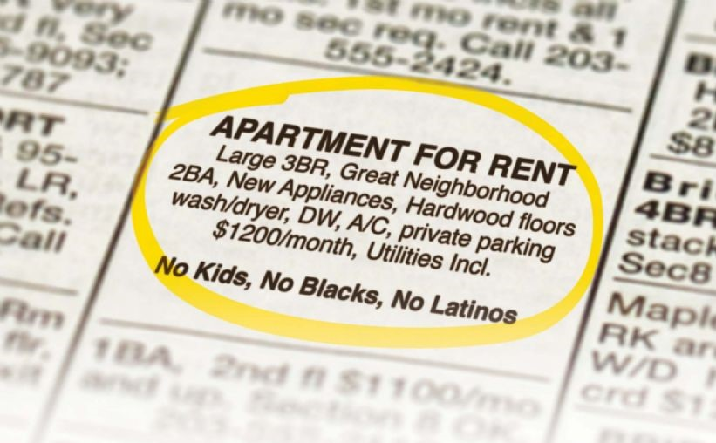
Prohibited Conduct
Discriminatory Advertising & Statements
To make, print or publish any notice, advertising or statement that indicates a preference, limitation, or discrimination.
  This includes posted signs, newspapers, Craigslist, Facebook, and others
To make any record or inquiry in connection with the prospective purchase, rental or lease of such a housing accommodation which expresses, directly or indirectly, any limitation, specification or discrimination.

Slide 14

Prohibited Conduct
Discrimination in Residential Real Estate-Related Transactions
  Discrimination in making available or in the terms or conditions of the transaction
  Includes:
    Making or purchasing of loans or providing other financial assistance for a dwelling or secured by residential real estate
      Maternity leave denials
      Steering
      Language Access
    The selling, brokering, or appraising of residential real property
      Racial discrimination in appraisals

Slide 15
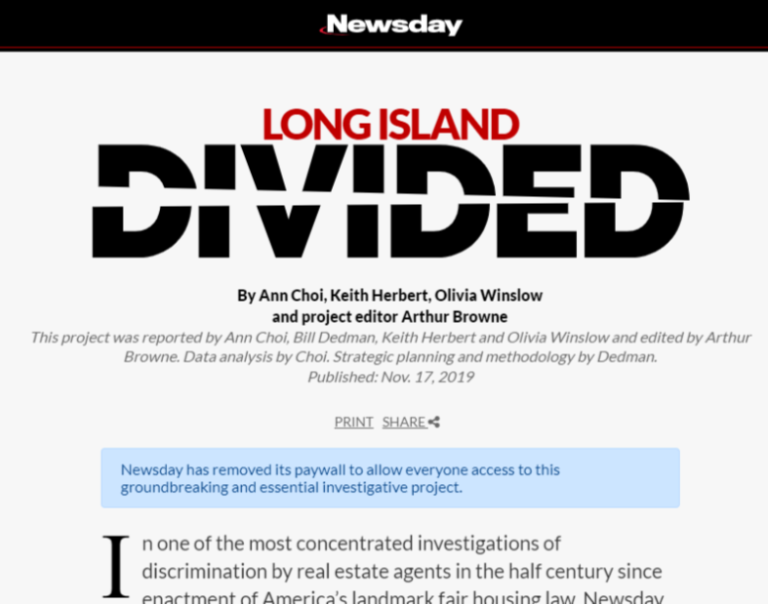
Housing Discrimination Today
Newsday “Long Island Divided” Investigation
  African-American testers posing as prospective home buyers encountered unequal treatment and/or racial steering 49% of the time. (November, 2019) (Video – Testing the Divide)

Slide 16
Housing Discrimination Today
Appraisal Bias – Homes owned by Black homeowners are undervalued, stripping households of their wealth
Love Letters – Introduce bias into home buying process by making personal characteristics of buyers a basis for accepting a purchase offer
Competitive market favors cash buyers and conventional loans – makes it difficult to purchase with FHA or VA loans which are disproportionately used by Black and Hispanic households

Slide 17
“Such projects could disrupt community cohesiveness and its underpinnings, which are essential to its health, safety and stability”
“I am looking to purchase a home in Cicero and I do not want it to be near a housing project.”
“Rising in the cost of tax, increased traffic concerns, potential increase of crime”
“We don’t want transients walking through our neighborhood.”
It doesn’t fit in with the neighborhood character and will increase traffic.
Zoning Processes Create Outlet for Neighborhood Opposition
Our schools can’t handle the increased enrollment
“I moved here because I didn’t want to live in the city with the riff raff…And I don’t want to deal with the bad things that 108 apartments would bring into the neighborhood with those type of people with those type of problems.”
“I am concerned the type of people this will attract to the area...”

Slide 18

Current Source of Income Laws
April 2019 - New York State added “lawful source of income” as a protected class under the state fair housing laws
  individuals can not be discriminated against due to the source of the income they use to pay housing costs
  includes all legal sources of income such as Section 8 vouchers, SSI, SSD, Public Assistance, HOPWA subsidies, Olmstead vouchers, child support, and alimony.
  includes one-time payments and emergency payments such as security deposit agreements from DSS or ERAP

Slide 19
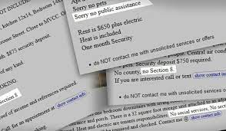
What about ads that say “No Section 8” or “ No PA” ?
Ads that indicate a preference, limitation, or discrimination based on a protected class violate fair housing laws. This includes ads indicating a limitation based on source of income. This includes language like “no programs” or “working people only.”

Slide 20
What about income & credit requirements?
Income requirements:
Can only apply to the tenant’s portion of the rent. For instance, if the rent for an apartment is $800 and the tenant portion is $200, the landlord can only require that the tenant make $600, which is three times their portion.
Credit Requirements:
While there is no definitive case law on this, there may be situations where use of a credit score to disqualify a tenant with a subsidy could be discriminatory.

Slide 21

Can a housing provider charge different rents for voucher holders?
No - it is a different term based upon a protected class, which is a violation of fair housing laws. Also, it is defrauding the housing authority, which comes with its own legal consequences.
Exception for LIHTC properties because LIHTC units have reduced rent.
Payment standards are set according to the Fair Market Rent or FMR of an area. Individual housing authorities have discretion to set their voucher values between 90 and 110% of FMR.

Slide 22
Criminal Background Screening
Blanket bans on individuals with justice involvement are considered discriminatory
Housing provider should conduct an individualized assessment that considers:
Nature and severity of offence
Time since conviction
Behavior in intervening time
Provider should be prepared to show their policy serves a “substantial, legitimate, nondiscriminatory interest”

Slide 23
Domestic Violence
Domestic violence survivors are protected under fair housing laws and other state laws
Housing providers can not evict domestic violence survivors because of incidents or police activity at the property
Local governments can not require that landlords evict domestic violence survivors because of police activity
Domestic violence survivors living in subsidized properties have rights under VAWA
Emergency transfers
Self-certification by survivors
Can’t deny housing due to adverse effects of abuse

Slide 24
Limited English Proficiency
For tenants with limited English proficiency (LEP), language access is a significant barrier to equal housing opportunity. As such, refusal to rent to households simply because the do not speak English constitutes discrimination on the basis of national origin.
CNY Fair Housing vs. Swiss Village – case alleging refusal to rent if there were no English-speaking adults in the household

Slide 25

Limited English Proficiency
Federally funded properties have additional requirements for LEP residents.
  Such housing providers must provide meaningful access to persons with limited English proficiency and have a language access plan in place.
  This often consists of providing leases and other rental documents in the language of the tenant and providing direct interpretation services when necessary.
  Failure to have and follow the plan is also considered discrimination on the basis of national origin.

Slide 26

Harassment in Housing
Fair Housing Act and New York State Human Rights Law provide protections against harassment based on protected class
Includes Harassment based on Race, Ethnicity, Sexual Orientation, Disability, etc.
Sexual harassment is covered under gender protections
Two types of harassment:
Quid pro quo – involves the exchange of sexual favors for rental benefits
Hostile environment – severe and pervasive conduct that creates a hostile environment

Slide 27
Harassment
Harassment can be written, verbal, or other conduct, and does not require physical contact
A housing provider cannot retaliate because someone asserted their fair housing rights or helped someone else assert their fair housing rights

Slide 28

Hostile Environment Harassment
Examples:
Use of lewd comments or gestures
Exposure
Use of gender-related derogatory comments
Displays of lewd photos or pictures
Asking about sex life or relationships
Use of racial and ethnic slurs
Derogatory comments about disability
  Factors considered to determine whether hostile environment exists:
  nature and context of the conduct
  severity, scope, frequency, duration, and location of the conduct
  relationships of the persons involved
  even a single event that it is severe enough, can still arise to the level of hostile environment

Slide 29
Quid Pro Quo Harassment
Involves an exchange or request for sexual favors for rental benefits
Rental benefits may include:
Ability to rent an apartment
Favorable application review
Reduction in rent
Reduction in security deposit
Maintenance
Forgiveness of back rent

Slide 30
Quid Pro Quo Harassment
  Requests may be explicit or subtle:
Suggestions of trades
Suggestions of “owing” something to landlord
Requests for dates
Attempts by landlord to get tenant alone
Even if the tenant acquiesces, it is still sexual harassment.

Slide 31
Disability Discrimination
Housing providers:
  Cannot refuse to rent or sell to prospective residents based upon their disability;
  Should not ask questions about the nature or extent of a person’s disability;
  Are obligated to provide equal access and opportunity for persons with disabilities to use and enjoy the housing.

Slide 32
Design & Construction
Buildings containing 4 or more units built after 1991 must meet minimum accessibility standards
Applies to buildings that are substantially rehabbed (more than 50%)
Seven basic requirements:
1. An accessible building entrance on an accessible route.
2. Accessible common and public use areas.
3. Usable doors (usable by a person in a wheelchair).
4. Accessible route into and through the dwelling unit.
5. Light switches, electrical outlets, thermostats and other environmental controls in accessible locations.
6. Reinforced walls in bathrooms for later installation of grab bars.
7. Usable kitchens and bathrooms.

Slide 33

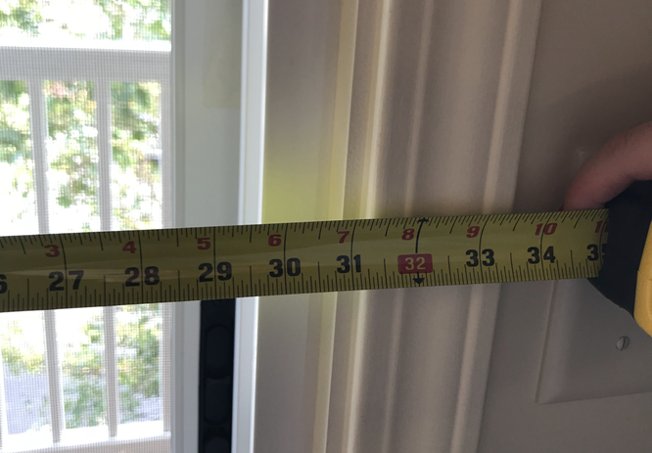
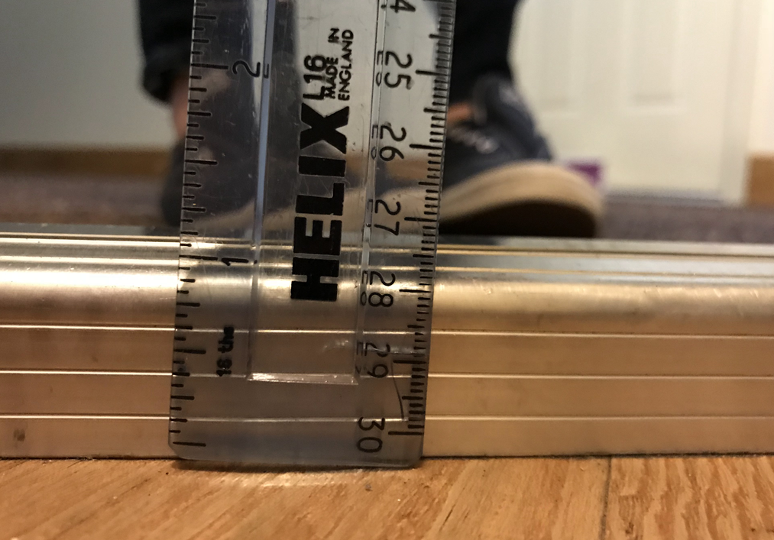
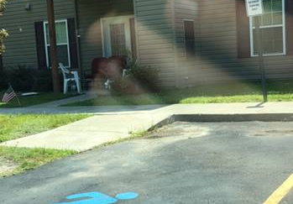
Design & Construction
Common violations:
  Thresholds at doorways, especially balconies and patios
  Insufficient door width
  Maneuvering space in bathrooms and kitchens
  Lack of access at common amenities like garages, storage spaces, and mailboxes
  Lack of access at rental offices
  Lack of curb cuts, excessive slope on sidewalks

Slide 34
Reasonable Accommodations
Accommodation: a change, exception, or adjustment in normal rules, policies, practices, or services offered by a housing provider to allow persons with disabilities the full use and enjoyment of their dwelling and related facilities.

Slide 35
Reasonable Accommodations - Examples
Assistance animals
Assigned parking spaces
Transferring Units
Communication methods
Trash Pickup
Snow Removal
Leniency for behavior that violates a lease

Slide 36
Reasonable Modifications
Modification: a structural modification that is made to allow persons with disabilities the full use and enjoyment of their dwelling and related facilities.

Slide 37

Reasonable Modifications - Examples
Ramps
Grab bars
Sidewalks
Power Assisted Doors
Flashing smoke alarms or door bells

Slide 38
Reasonable Modifications
Federally subsidized housing (includes HUD and USDA subsidized housing) - housing provider is responsible for costs of all modifications.
Private housing - tenant is responsible for paying for modifications within their units while the landlord is responsible for paying for some modifications to common areas.
If modifications are necessary due to failure to comply with design and construction standards, the housing provider is responsible for paying for the modification

Slide 39
Disability Under Fair Housing Laws
“Any person who has a physical or mental impairment that substantially limits one or more major life activities; has a record of such impairment; or is regarded as having such an impairment.”
Examples:
mobility impairments
visual or hearing impairments
major diseases
mental illness
depression
anxiety
PTSD
autism

Slide 40

What is Reasonable?
Changes that do not impose an undue financial and administrative burden or that would fundamentally alter the provider’s operations
Takes into account:
  the financial resources of the provider
  the costs of the accommodation or modification
  the benefits to the requester
  the availability or other, less expensive alternative options

Slide 41

What are insufficient reasons for denial?
Aesthetics
Everyone will want the same thing
It’s not fair to others

Slide 42

What is required to request a reasonable accommodation or modification?
Request does not need to be made in a particular way
  Recommend that requests be made in writing and ask that the housing provider responds in writing
  Housing provider may have a particular form or process, but they can’t require tenant use that form or process.
If the disability is not obvious, tenant should be prepared to provide information from a third party that:
  verifies that they meet the Act’s definition of disability
  describes the needed accommodation or modification
  shows the relationship between the person’s disability and the need for the requested accommodation and modification

Slide 43

How can a housing provider verify that a tenant has a disability?
Verification does not need to be from a doctor but should be someone familiar with the disability and need.
  Best practice - verification from someone with professional training though in limited circumstances there may be exceptions if that is not possible.
A housing provider can not ask for information about the individual’s diagnosis or other treatment they have pursued including asking for information about medications the individual is taking or has taken in the past.

Slide 44

Can a housing provider charge fees for accommodations?
Housing provider cannot charge additional fees as a condition of granting the accommodation or modification
  Includes pet fees and pet deposits for assistance animals, parking fees, or transfer fees if an individual needs to switch units for a disability related need
  Cannot be called an “administrative fee”

Slide 45

Is it a service animal?
Service animals under the ADA must be:
  A dog,
  Required because of a disability, and
  Trained to perform a task.
  All requests for service animals must be granted, but just because it is not a service animal does not mean the housing provider can deny the request.

Slide 46
What animals can be considered support animals?
All animals reasonably kept in households, including a dog, cat, small bird, rabbit, hamster, gerbil, other rodent, fish, turtle, or other small, domesticated animal that is traditionally kept in the home for pleasure rather than for commercial purposes.
Unique animals can be support animals, but the requester must specifically demonstrate a disability-related need for that specific type of animal. For example:
  The animal is individually trained to do work or perform tasks that cannot be performed by a dog.
  Information from a health care professional confirms that:
    Allergies prevent the person from using a dog; or
    Without the animal, the symptoms or effects of the person’s disability will be significantly increased.
  The individual seeks to keep the animal outdoors at a house with a fenced yard where the animal can be appropriately maintained

Slide 47


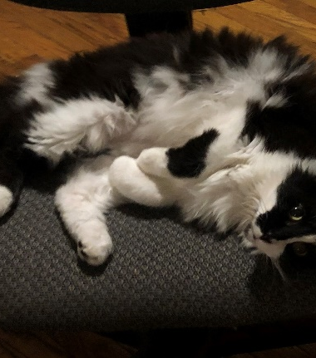

What if the animal is dangerous?
If the requested animal is dangerous or becomes dangerous to other tenants or property, the housing provider can require that the animal no longer be allowed in the housing. This includes biting or menacing behavior, but does not include typical animal behavior such as occasional noise making.

Slide 48

What restrictions can a landlord place on an animal?
Reasonable restrictions would include anything that would be covered by local laws such as using a leash in common areas, vaccinations, and picking up after the animal.
Excessive restrictions may include:
  Breed and size restrictions
  Excessive safety restrictions that are unrelated to the animal’s behavior
  Not allowing the animal in common areas
  Forcing the animal to leave the property to relieve itself
  Strict no barking policies

Slide 49
Enforcement of Fair Housing Complaints
  Fair Housing complaints can be filed in:
    Federal Court: if there are claims covered under the Fair Housing Act (e.g. disability)
    State Court: if there are claims covered under state Human Rights Law (e.g. source of income)
    HUD
    NYS Division of Human Rights

Slide 50
Remedies in Fair Housing Cases
  Monetary Damages:
  Compensatory damages (moving costs, missed work)
  Emotional damages (mental anguish and humiliation)
  Punitive damages - acted with knowledge that the action violated the law or with reckless indifference to the plaintiff’s rights
Injunctive Relief:
  Affirmative remedies (e.g. requiring landlord to rent to tenant, requiring affirmative marketing)
  Training
  Continued monitoring

