Slide 1

Fair Housing Rights

Slide 2
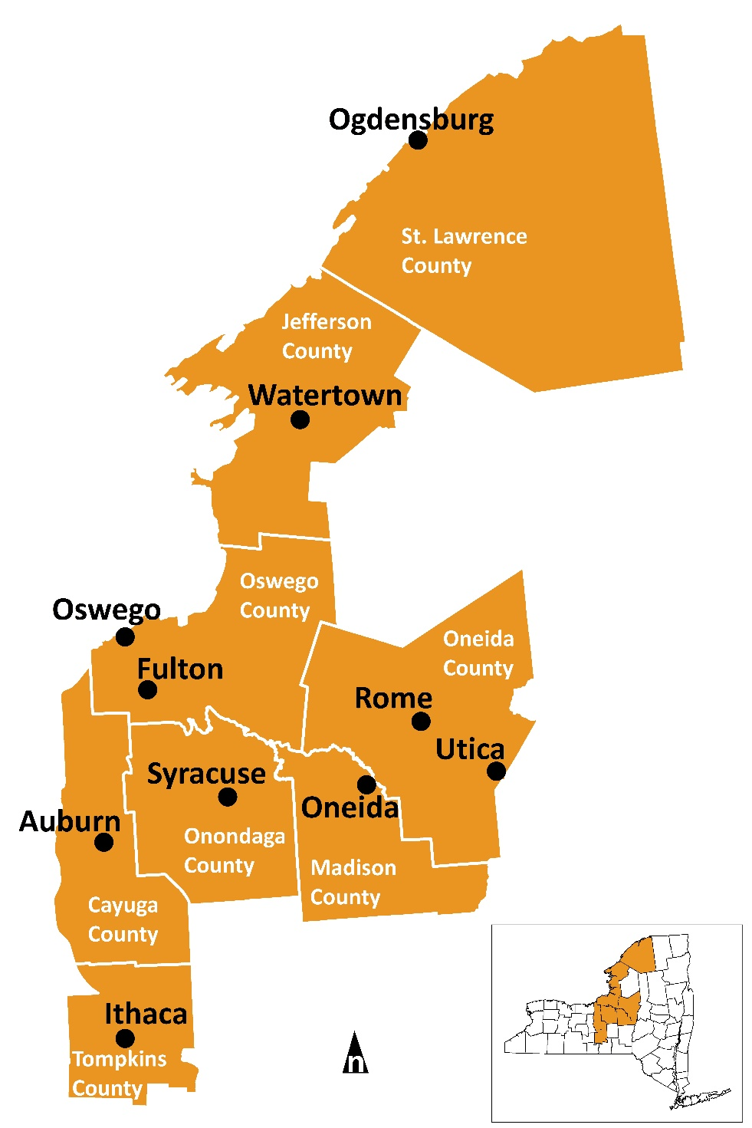
About CNY Fair Housing
Private, non-profit organization founded in 1991
Conduct around 200 investigations of housing discrimination per year and train around 2,000 people
Funded by HUD, Onondaga County, Cities of Syracuse, Utica, Auburn, and Watertown, and through private donations and contractual services

Slide 3
Disclaimer
Nothing presented here either verbally or in writing is legal advice. Please consult an attorney for legal advice.

Slide 4
Protected Classes Under Fair Housing Laws
Federal Law:
Race
Color
National Origin
Religion
Sex/Gender
Disability
Familial Status (families w/children)
State Law:
Age
Marital Status
Military Status
Sexual Orientation
Gender Identity
Source of Income
Local Laws:
Example: height and weight

Slide 5
Familial Status
Familial Status: families with children under the age of 18, pregnant women, anyone who has or is trying to obtain custody of minor children (adoption, foster care, grandparents)
General guidelines on occupancy standards (local laws may apply):
Bedroom for 1 person – Greater than 70 square feet
Bedroom for 2 or more persons – Greater than 50 square feet per person
Children under 2 years old do not count in determining occupancy

Slide 6
Who must comply with the law?
Anyone involved in the provision of housing and residential lending
  Includes property owners, housing managers, housing staff, housing associations, lenders, real estate agents, and brokerage services and in some cases, state and local governments

Slide 7
Exemptions in NYS
Owner-occupied two-unit dwellings
Religious organizations may limit housing to their members.
Senior housing may limit occupancy as follows:
  All units occupied by those 62 and over
  80% of units occupied by at least one person 55 or over
  Senior housing may advertise itself as such
Discrimination based on race and national origin and discriminatory statements and discriminatory advertising are not subject to the exemptions – they are always illegal.

Slide 8
What conduct is illegal?
Refusal to rent, sell or negotiate
To discriminate in terms or conditions (including steering)
To discriminate in advertising or making statements
To lie about the availability of a dwelling
Refusal to allow reasonable accommodations/modifications

Slide 9
What conduct is illegal?
Failure to design and construct multi-family housing in accordance with accessibility standards
Discriminatory zoning and land-use actions, including:
  Refusal to allow or undue restrictions on group homes for persons with disabilities
  Restrictive zoning based on age/familial status
  Providing different services and amenities based on the racial or ethnic make-up of neighborhoods

Slide 10
What conduct is illegal?
Discriminating in financing, appraising, or making any loan that is secured by residential real estate
Discriminating in providing homeowners’ insurance
Sexual harassment
Harassment, intimidation or interference based on protected class membership or because someone has attempted to protect rights under fair housing laws

Slide 11
Disparate Impact
Policies that appear neutral on their face but have a disproportionate negative impact on persons of a protected class.
Example: A landlord can not have a policy that they will only accept income from work because it would have a disparate impact on people with disabilities and women and families with children who may receive child support.
Notes:
Other examples: requiring people on disability to prove that they will have continued benefits, denying housing to victims of domestic violence

Slide 12
What we’re seeing
Landlord doesn’t call prospective tenant back
Landlord treats prospective tenant different in person
Actual rent amount is higher than what was advertised
Tenant is told the apartment is rented but it continues to be advertised
Landlord tries to steer the tenant to a particular apartment or building
There are rules that apply only to the tenant or to children
Landlord makes negative comments about the tenant’s race, ethnicity, disability, children, etc.

Slide 13
What we’re seeing
“It isn’t safe for kids.”
“A boy and a girl can’t share a bedroom.”
“Working people only”
“Quiet, clean professionals preferred.”
“You might feel more comfortable in another neighborhood.”
“We only take English speaking people.”
“Sorry, we just rented the last apartment.”

Slide 14
Reasonable Accommodations & Modifications
Accommodation - A change, exception, or adjustment in normal rules, policies, practices, or services offered by a housing provider to allow persons with disabilities the full use and enjoyment of their dwelling and related facilities
Examples: Assistance animals, assigned parking spaces, vacating a lease, leniency for behavior that violates a lease (hoarding, disruptive behavior)

Slide 15
Reasonable Accommodations & Modifications
Modification - A structural modification that is made to allow persons with disabilities the full enjoyment of the housing and related facilities
Examples: Grab bars, ramps
In private housing, tenant is responsible for paying for modifications within their units while the landlord is responsible for paying for some modifications to common areas.

Slide 16
Disability Under the Fair Housing Act
“Any person who has a physical or mental impairment that substantially limits one or more major life activities; has a record of such impairment; or is regarded as having such an impairment.”
Examples: Mobility impairments, visual or hearing impairments, major diseases, mental illness, depression, anxiety, PTSD, autism, addiction (in treatment)

Slide 17
What is reasonable?
Changes that do not impose an undue financial or administrative burden or that would fundamentally alter the provider’s operations
Takes into account
- the financial resources of the provider
  - the costs of the accommodation or modification
  - the benefits to the requester
  - the availability or other, less expensive alternative options

Slide 18

What is required for a reasonable accommodation or modification?
Request does not need to be made in a particular way
  Recommend that requests be made in writing and ask that the housing provider responds in writing
Person should be prepared to provide information from a third party
  verifies that they meet the Act’s definition of disability
  describes the needed accommodation
  shows the relationship between the person’s disability and the need for the requested accommodation.
Verification does not need to be from a doctor but should be someone familiar with the disability and need.

Slide 19
What is required for a reasonable accommodation or modification?
Housing provider can not refuse to engage in a negotiation over a reasonable accommodation
An undue delay in the consideration of an accommodation may be considered a failure to provide the accommodation
Housing provider can not charge additional fees as a condition of granting the accommodation – includes pet fees and pet deposits for assistance animals
Housing provider can not place excessive restrictions related to the accommodation
  Includes breed and size restrictions
  Reasonable restrictions may include leashing, picking up after animal, rabies vaccines

Slide 20
Harassment
  Quid Pro Quo and Hostile Environment Harassment and Liability for Discriminatory Housing Practices under the Fair Housing Act
  HUD Final Rule Effective 10/14/2016
    Rule formalizes standards for evaluating claims of ‘quid pro quo’ and hostile environment harassment in the housing context.
    Focused on sexual harassment, but addresses harassment based on any prohibited basis.
    Makes specific definitions of “quid pro quo harassment” and “hostile environment harassment”.
  Addresses both harassment by provider or provider’s agent and harassment between parties over which provider has control (i.e. Tenant-to-Tenant)
  Rule provides guidance to providers of housing or housing-related services seeking to ensure that their properties or businesses are free of unlawful harassment.

Slide 21
Harassment
  Rule provides illustrations of discriminatory housing practices that constitute such harassment
  Rule clarifies the operation of traditional principles of direct and vicarious liability in the Fair Housing Act context
  Landlord will have liability for failure to act when they knew or should have known of the harassment
  Tenant to Tenant Harassment
    Landlord has a duty to act
    Typically ‘hostile environment’ form of harassment
    Factors considered to determine whether hostile environment exists include the nature of the conduct, the context in which the incident(s) occurred, the severity, scope, frequency, duration, and location of the conduct, and the relationships of the persons involved

Slide 22
Harassment
What to do if someone is a victim of harassment:
Contact the police if needed
Document or record interactions with the harasser
Notify your landlord in writing if you are being harassed by a neighbor and ask for a response in writing
Notes:
Legitimate threats on someone’s life

Slide 23
Criminal Background Screening
Application of Fair Housing Act Standards to the Use of Criminal Records by Providers of Housing and Real Estate-Related Transactions
  Issued April 4, 2016
Blanket Screening Criteria Without Individualized Inquiry or Assessment May Be Housing Discrimination
  Disqualification for Arrest Record Alone Not Permissible, as Arrest Not Equivalent to Adjudication
Individualized Assessment Should Consider:
  Nature and Severity of Offence
  Time Since Conviction
  Behavior In Intervening Time
Provider Should be Prepared to Show Policy Serves “Substantial, Legitimate, Nondiscriminatory Interest”

Slide 24
Domestic Violence
Application of Fair Housing Act Standards to the Enforcement of Local Nuisance and Crime-Free Housing Ordinances Against Victims of Domestic Violence, Other Crime Victims, and Others Who Require Police or Emergency Services
HUD issued new guidance on nuisance and crime-free ordinances to make certain they don’t violate victim’s rights under the Fair Housing Act.
Too often these ordinances required or were used by landlords to evict victims of domestic violence based on the amount of 911 calls placed during a certain time period, rather than based on if the tenant was committing a crime.
This caused women to be hesitant to call 911 when in danger.
Women, particularly low-income women of color, are disproportionately at risk for domestic violence and thus, these ordinances had a disparate impact on a protected class.

Slide 25
Domestic Violence
Violence Against Women Reauthorization Act of 2013: Implementation in HUD Housing
Clarifies emergency transfer process, encourages housing providers to allow domestic violence victims to self certify without paperwork, and allow for immediate transfer to safe unit (if available) without application.
Covered housing providers cannot deny applications based off effects of past domestic violence. This includes poor rental history due to domestic disturbance, poor credit due to an abusive partner intentionally ruining credit etc.

Slide 26
Sexual Orientation and Gender Identity
Equal Access in Accordance with an Individual's Gender Identity in Community Planning and Development Programs
HUD issued this final rule ensuring equal access to individuals in accordance to their gender identities in shelter and programs for all programs administered by HUD’s Office of Community Planning and Development.
This builds off of Equal Access to Housing in HUD Programs Regardless of Sexual Orientation or Gender Identity Rule in 2012 which aimed to ensure that HUD’s housing programs would be open to all regardless of gender identity, sexual orientation, or marriage status.

Slide 27
Limited English Proficiency
Fair Housing Act Protections for Persons with Limited English Proficiency
HUD ruled that people with limited English proficiency, while not technically a protected class, are protected under fair housing laws due to a close linkage with nation of origin, which is a protected class
This means that housing providers are prohibited from using limited English proficiency selectively or as an excuse for housing discrimination

Slide 28
Enforcement
Complaints of illegal housing discrimination may be filed directly with HUD or with NYS Division of Human Rights or in state or federal court.
Possible penalties include compensatory damages, punitive damages, and administrative penalties.

Slide 29

Fair Housing
Questions/Inquiries?
CNY Fair Housing, Inc.
731 James Street, Suite 200
Syracuse, NY 13203
Phone: (315) 471-0420
Website: www.cnyfairhousing.org

